Slide 1
CSE – 3rd Semester
COMPUTER ARCHITECTURE & ORGANIZATION
Notes:
Manav Rachna College of Engineering

Slide 2
Introduction to Sequential Circuits
Inputs
Outputs
Combina-tional
Logic
A Sequential circuit contains:
  Storage elements:
  Latches or Flip-Flops
  Combinational Logic:
    Implements a multiple-output switching function
    Inputs are signals from the outside.
    Outputs are signals to the outside.
    Other inputs, State or Present State, are signals from storage elements.
    The remaining outputs, Next State are inputs to storage elements.
Storage Elements
Next
State
State

Slide 3
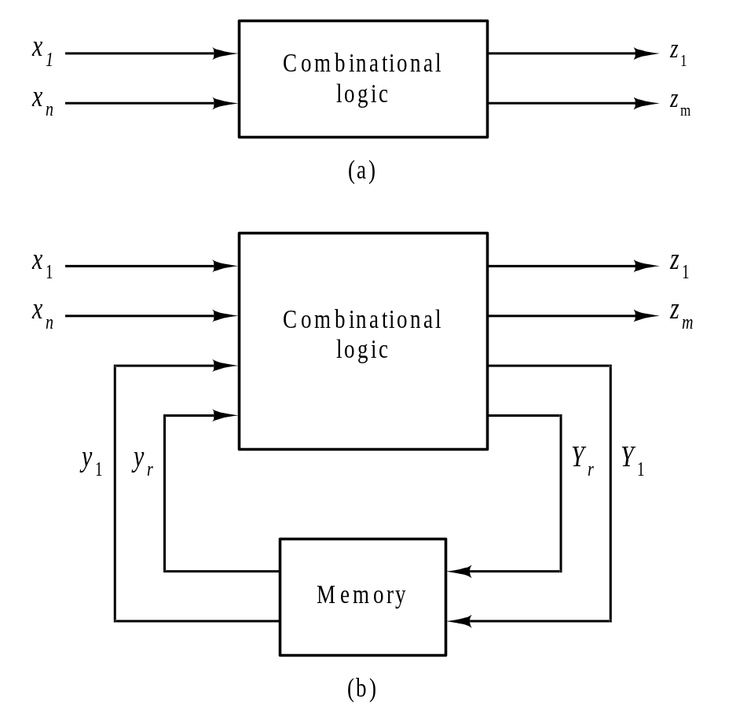
The Sequential Circuit Model
Figure 6.1

Slide 4
Types of Sequential Circuits
Depends on the times at which:
  storage elements observe their inputs, and
  storage elements change their state
Synchronous or clocked
  Storage elements observe inputs and can change state only in relation to a timing signal (clock pulses from a clock). In this we use a master oscillator which provide regular timing pulse.
Asynchronous or unclocked
  In this the circuit events can occur after one event is completed and there is no waiting for the timing pulse.

Slide 5
Flip-Flops
The memory elements used in clocked type sequential circuits are called Flip-Flops.
Flip-Flops are also known as bistable multi-vibrators, latches, multibinary and toggles.
Flip-flops are inter connected to form sequential logic circuits, such as storage circuits, counters, shift registers and in various other computer applications.

Slide 6
Basic (NOR) S – R Latch
Cross-coupling two
NOR gates gives the
S – R Latch:
Which has the time sequence behavior:
R (reset)
Q
S (set)
Q
Time
R
S
Q
Q
Comment
0
0
?
?
Stored state unknown
0
1
1
0
“Set” Q to 1
0
0
1
0
Now Q “remembers” 1
1
0
0
1
“Reset” Q to 0
0
0
0
1
Now Q “remembers” 0
1
1
0
0
Both go low
0
0
?
?
Unstable!

Slide 7
Clocked S - R Latch
Adding two NAND
gates to the basic
S - R NAND latch
gives the clocked
S – R latch:
Has a time sequence behavior similar to the basic S-R latch except that the S and R inputs are only observed when the line C is high.
C means “control” or “clock”.
S
Q
C
Q
R

Slide 8
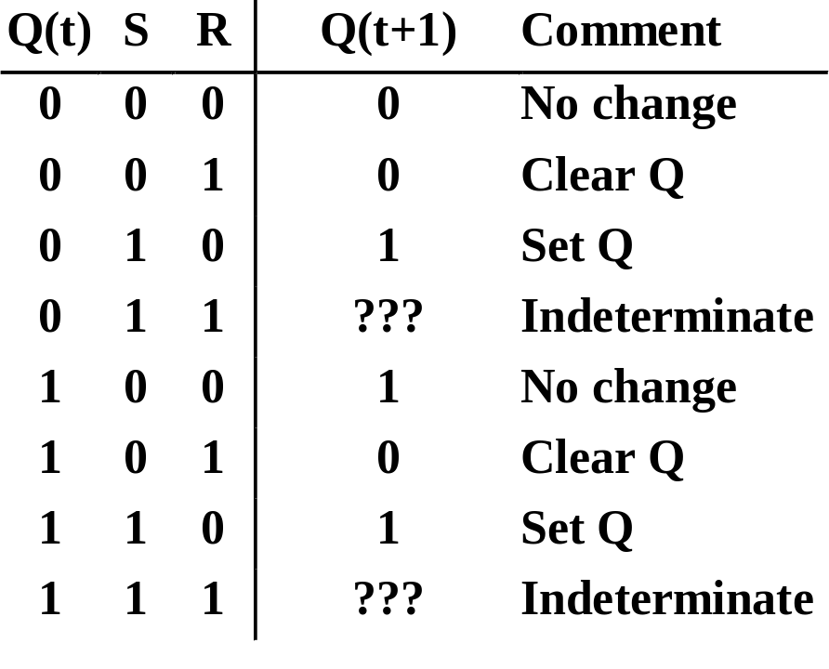
Clocked S - R Latch (continued)
The Clocked S-R Latch can be described by a table:
The table describes
what happens after the
clock [at time (t+1)]
based on:
  current inputs (S,R) and
  current state Q(t).
S
Q
C
Q
R

Slide 9

D Latch
D
Adding an inverter
to the S-R Latch,
gives the D Latch:
Note that there are
no “indeterminate”
states!
Q
C
Q
Q
D
Q(t+1)
Comment
0
0
0
No change
D
Q
0
1
1
Set Q
1
0
0
Clear Q
C
Q
1
1
1
No Change

Slide 10
S-R Master-Slave Flip-Flop
Consists of two clocked
S-R latches in series
with the clock on the
second latch inverted
The input is observed
by the first latch with C = 1
The output is changed by the second latch with C = 0
The path from input to output is broken by the difference in clocking values (C = 1 and C = 0).
The behavior demonstrated by the example with D driven by Y given previously is prevented since the clock must change from 1 to 0 before a change in Y based on D can occur.
S
S
Q
S
Q
Q
C
C
C
R
R
Q
R
Q
Q

Slide 11
Flip-Flop Problem
The change in the flip-flop output is delayed by the pulse width which makes the circuit slower or
S and/or R are permitted to change while C = 1
  Suppose Q = 0 and S goes to 1 and then back to 0 with R remaining at 0
    The master latch sets to 1
    A 1 is transferred to the slave
  Suppose Q = 0 and S goes to 1 and back to 0 and R goes to 1 and back to 0
    The master latch sets and then resets
    A 0 is transferred to the slave
  This behavior is called 1s catching

Slide 12
Flip-Flop Solution
Use edge-triggering instead of master-slave
An edge-triggered flip-flop ignores the pulse while it is at a constant level and triggers only during a transition of the clock signal
Edge-triggered flip-flops can be built directly at the electronic circuit level, or
A master-slave D flip-flop which also exhibits edge-triggered behavior can be used.

Slide 13
Edge-Triggered D Flip-Flop
The edge-triggered
D flip-flop is the
same as the master-
slave D flip-flop
It can be formed by:
  Replacing the first clocked S-R latch with a clocked D latch or
  Adding a D input and inverter to a master-slave S-R flip-flop
The delay of the S-R master-slave flip-flop can be avoided since the 1s-catching behavior is not present with D replacing S and R inputs
The change of the D flip-flop output is associated with the negative edge at the end of the pulse
It is called a negative-edge triggered flip-flop
D
D
Q
S
Q
Q
C
C
C
Q
R
Q
Q

Slide 14
Counters

Slide 15
Counters
Counters are one of the important digital electronic circuits used to count the occurrence of the event, or generating timing sequence to control operation in digital system. For e.g digital clock.
Counter circuits produces a well-defined output pattern sequence like:
3 Bit Up-counter: 000, 001, 010, 011, 100, 101, 110, 111, 000, ...
3 Bit Down-counter: 111, 110, 101, 100, 011, 010, 001, 000, 111, ...
Binary vs. BCD vs. Gray Code

Slide 16
The output pattern = state of the counter
Total number of states = modulus of counter
Counter with m states = modulus-m counter or mod-m counter

Slide 17
Asynchronous Binary Counters
Binary counters = counters whose counting sequence corresponds to binary numbers
Modulus of a binary counter is 2^{n}, where n is numer of flip-flops
Also known as ripple counter since a change in Qi flip-flop toggles the Qi+1 flip-flop

Slide 18
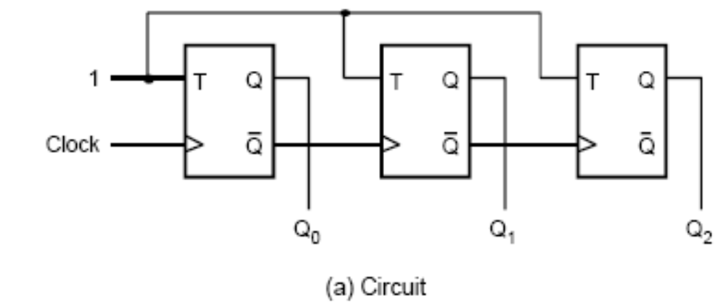
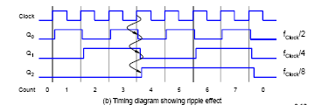
3-bit Asynchronous Up-Counter

Slide 19
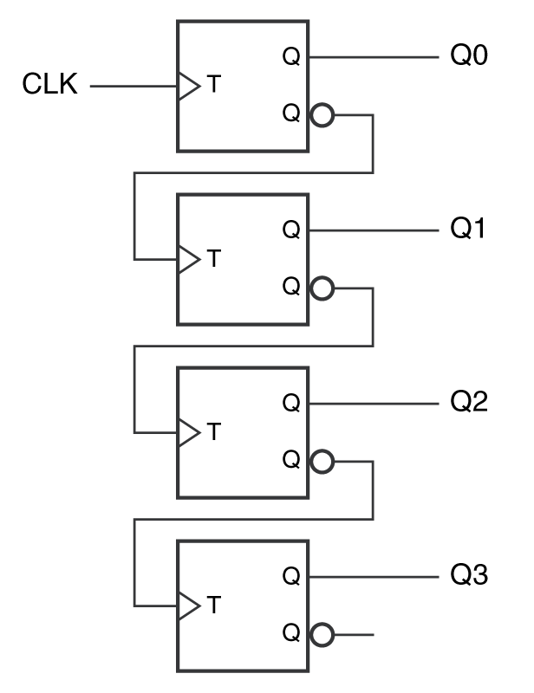
4-bit(Asynchronous) Ripple Counter
  Q3 Q2 Q1 Q0
  0 0 0 0
  0 0 0 1
  0 0 1 0
  0 0 1 1
  0 1 0 0
  0 1 0 1
  0 1 1 0
  0 1 1 1
  1 0 0 0
Q0
Q1
Q2
Q3

Slide 20
Synchronous Counters
All FFs are triggered simultaneously (in parallel) by clock input pulses.
All outputs change simultaneously
Simple counters use TFF or JKFF
JK inputs of the others FFs are driven by some combination of FF outputs.

Slide 21
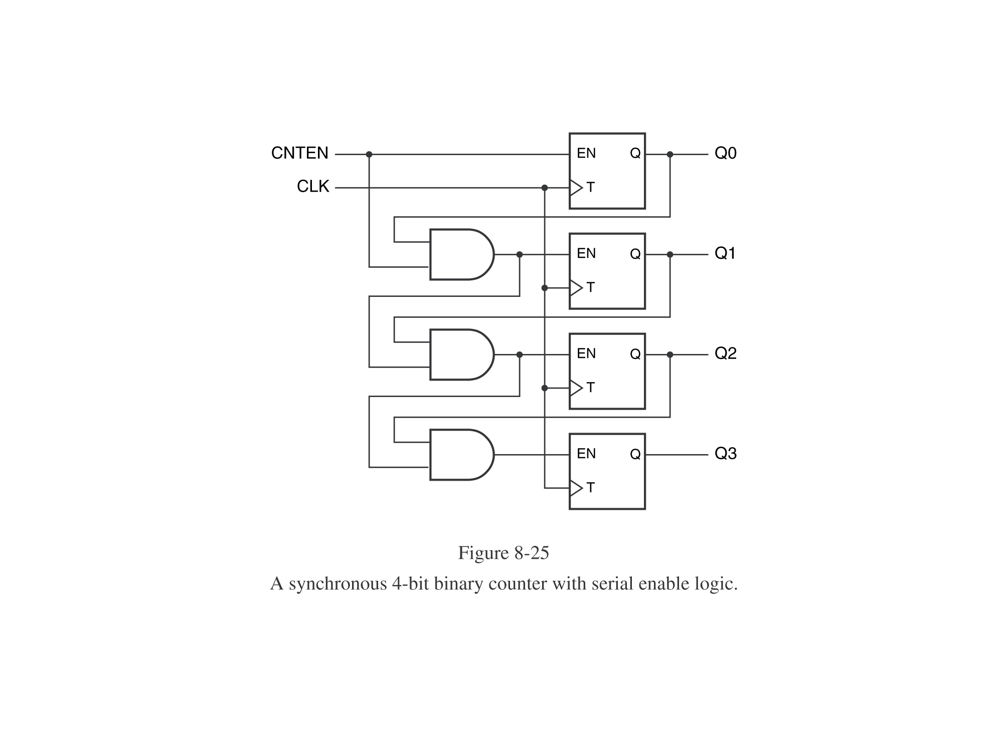
Synchronous Counter
Serial enable logic

Slide 22
Shift Registers

Slide 23
(Shift) Registers
  Registers are used for storage and transfer of binary information in a digital system.
  The storage capacity of a register is defied as a number of bits of digital data it can store or retain.
Types
  Serial-in, Serial-out
  Serial-in, Parallel-out
  Parallel-in, Serial-out
  Parallel-in, Parallel-out

Slide 24
Quad Register
Parallel-in, Parallel-out (no shift)
D3
D2
D1
D0
D
Q
D
Q
D
Q
D
Q
A
B
C
D
C
C
C
C
CLR
CLR
CLR
CLR
CK
CLR_L
PRESET_L
Q₃
Q₂
Q₁
Q₀

Slide 25
Serial-In, Serial-Out
RIN
D
Q
D
Q
D
Q
D
Q
Q_{D}
A
B
C
D
C
C
C
C
CLR
CLR
CLR
CLR
CK
CLR_L
PRESET_L

Slide 26
Serial-In, Parallel-Out
RIN
D
Q
D
Q
D
Q
D
Q
A
B
C
D
C
C
C
C
CLR
CLR
CLR
CLR
CK
CLR_L
PRESET_L
Q₃
Q₂
Q₁
Q₀

Slide 27
Parallel-In, Serial-out
D3
D2
D1
D0
RIN
L/S
I₀
I₁
I₀
I₁
I₀
I₁
I₀
I₁
D
Q
D
Q
D
Q
D
Q
Q_{D}
A
B
C
D
C
C
C
C
CLR
CLR
CLR
CLR
CK
CK
CLR_L
PRESET_L

Slide 28
Universal Shift Register
A
B
C
D
LIN
RIN
S₁
I₃
I₂
I₁
I₀
I₃
I₂
I₁
I₀
I₃
I₂
I₁
I₀
I₃
I₂
I₁
I₀
S₀
D
Q
D
Q
D
Q
D
Q
A
B
C
D
C
C
C
C
CLR
CLR
CLR
CLR
CK
CLR_L
PRESET_L
Q_{A}
Q_{B}
Q_{C}
Q_{D}

